Slide 1
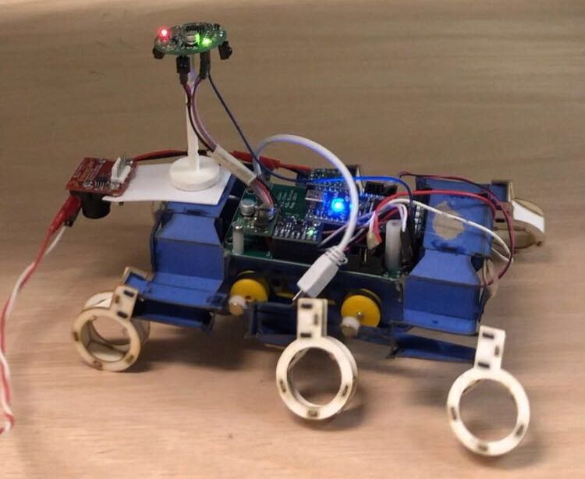
Beacon Based Orientation Control on OpenRoACH
Daniel Hua, Claire Dong

Slide 2
Motivation
Automatic Guidance System
Application in self-repair system
Clustered Transportation

Slide 3
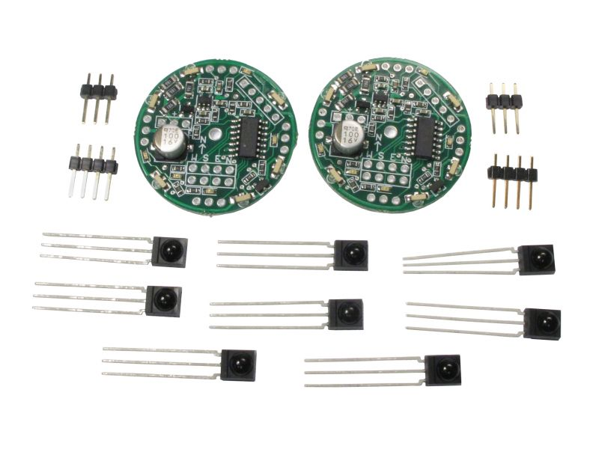
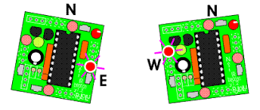
Approach
Polulu IR beacon pair
1Transmitter + 1Receiver

Slide 4
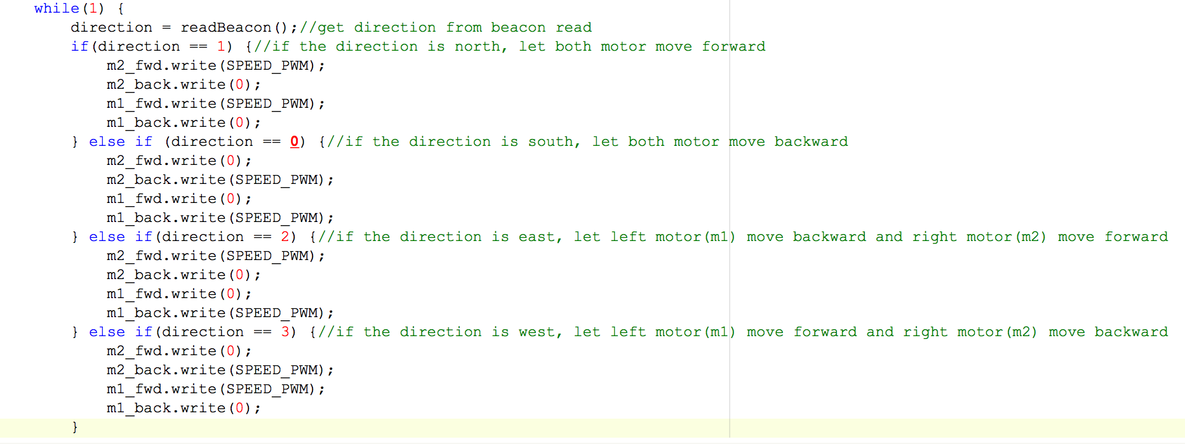
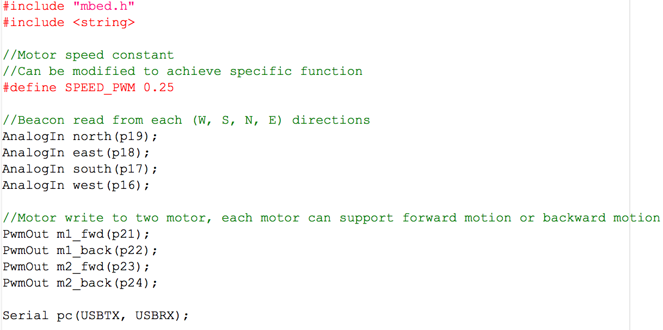
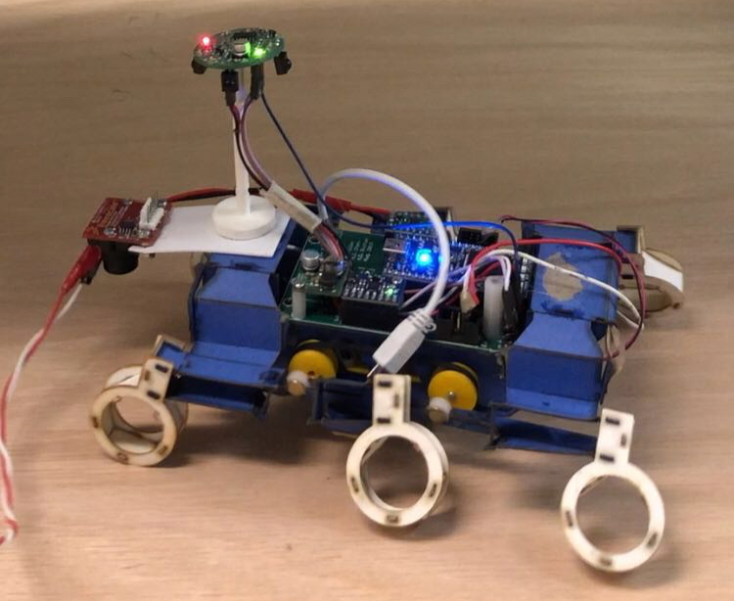
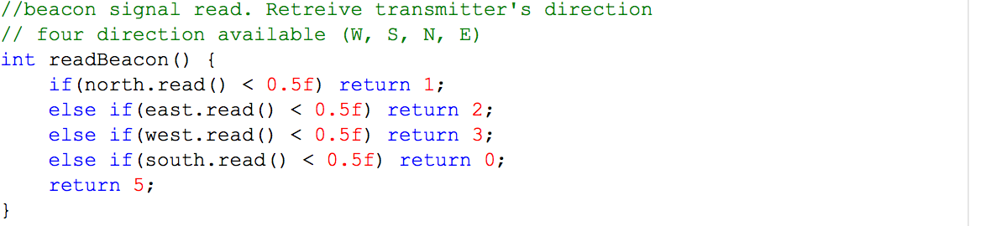
Approach

Slide 5
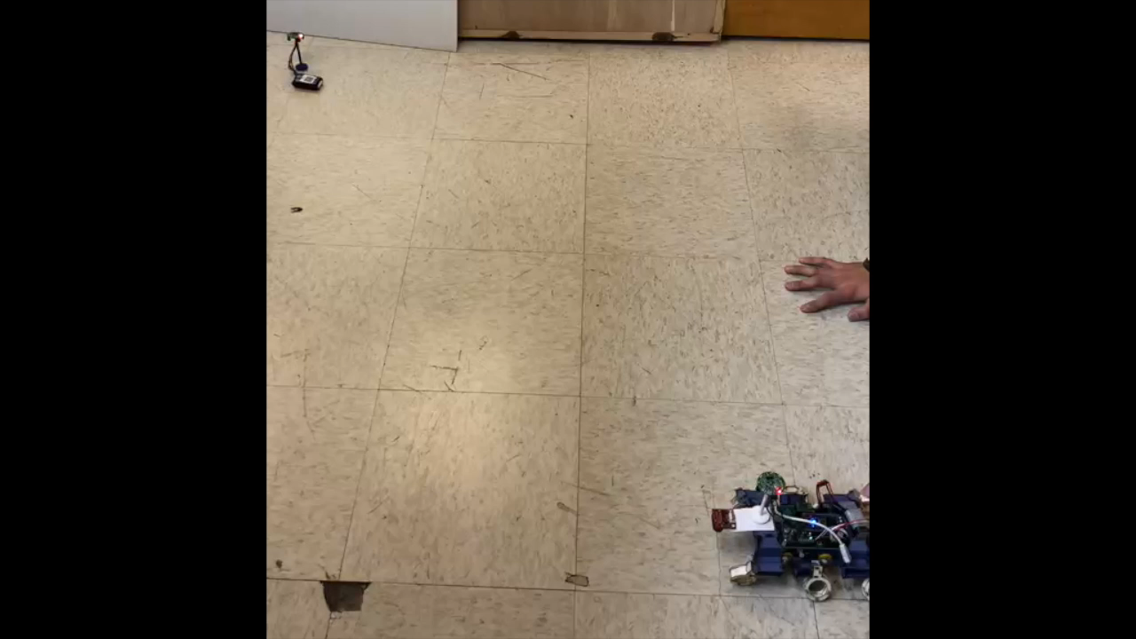
Result

Slide 6
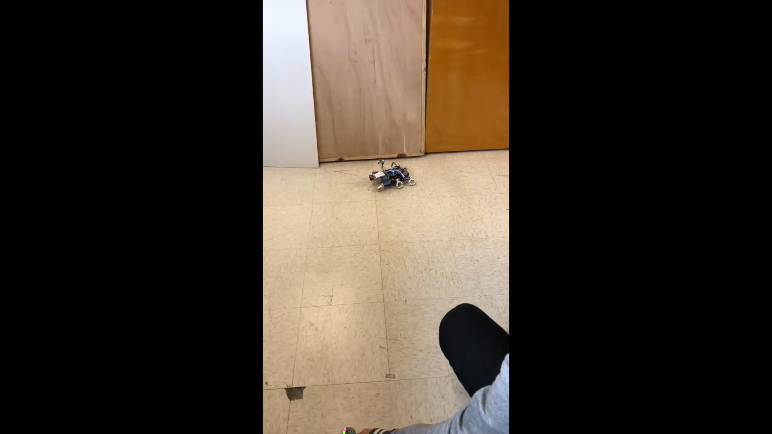
Result

Slide 7
Result
Easy implementation
Applicable to various robot platform
Good for following moving object
Restriction in the stationary applicable range (20-200cm)
Unpredictable in the actual pass taken

Slide 8
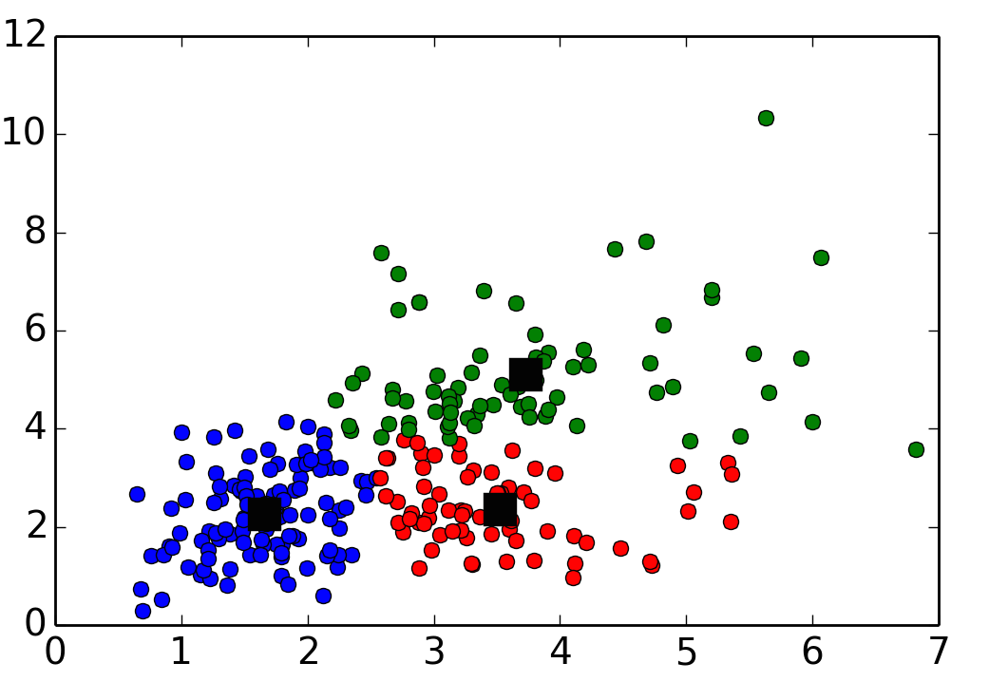
Possible Applications
OpenRoACH transportation in large number(cluster)

